Slide 1
Local animals
animals of pray

Slide 2
the first animal:
Lynx

Slide 3
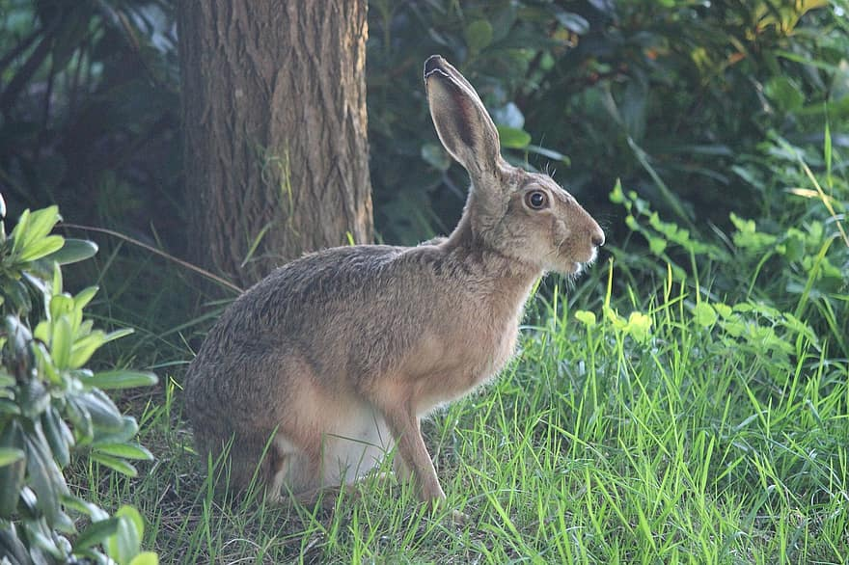
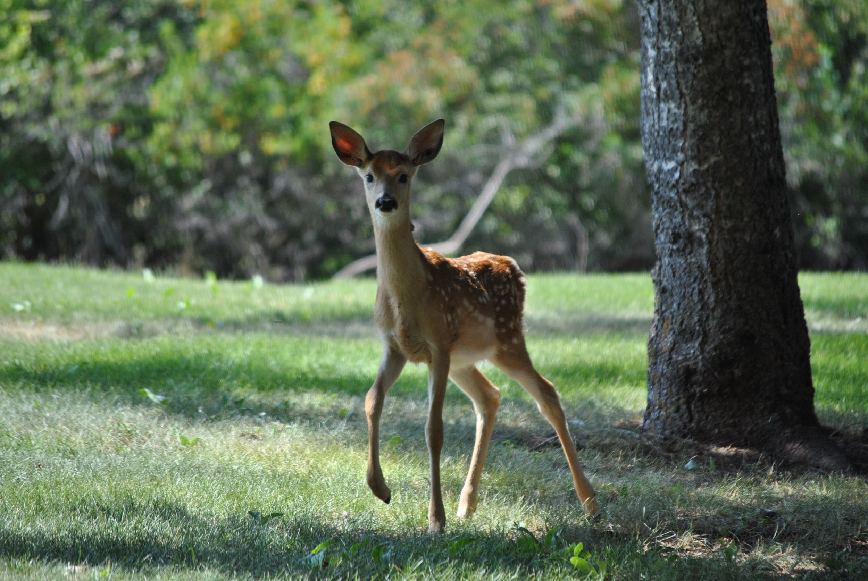
The linx is 148 cm long and weighs 35 kg.
They are up to 75 cm high and the tail is up to 25 cm long.
They have little pointed ears.
Their color is gray and yellow with brown and black spots.
They eat deer and hares.
hare
deer
Notes:
They have…, Their…, deer...

Slide 4
Linx history
In the Czech Republic, the feature was wipped out in the 15th to 17th centuries. By the 18th century, it wasn't even in most of the mountains. There are only a few left. He started coming back in 2006.

Slide 5
The second animal:
Wolf

Slide 6
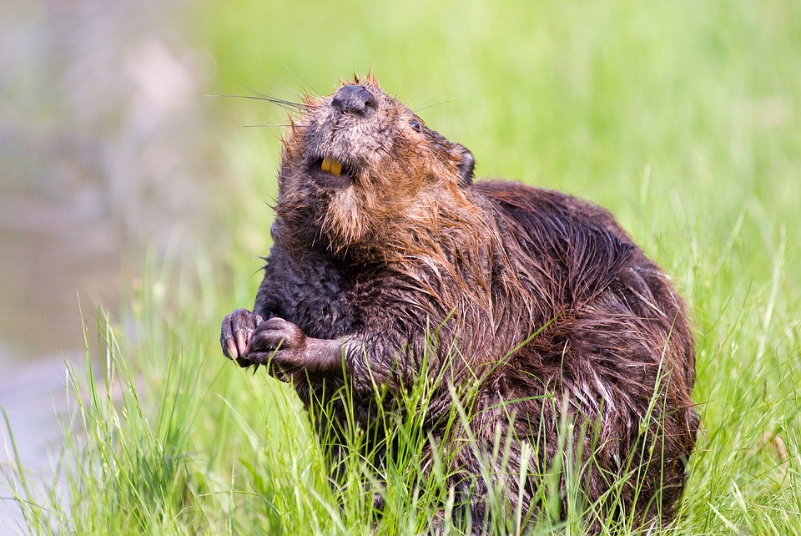
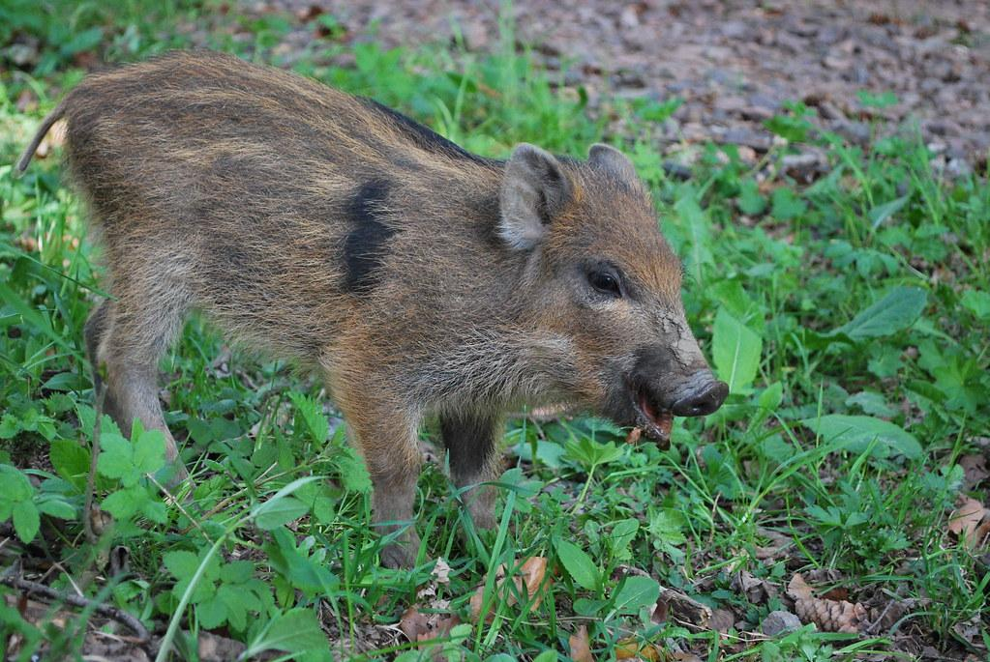
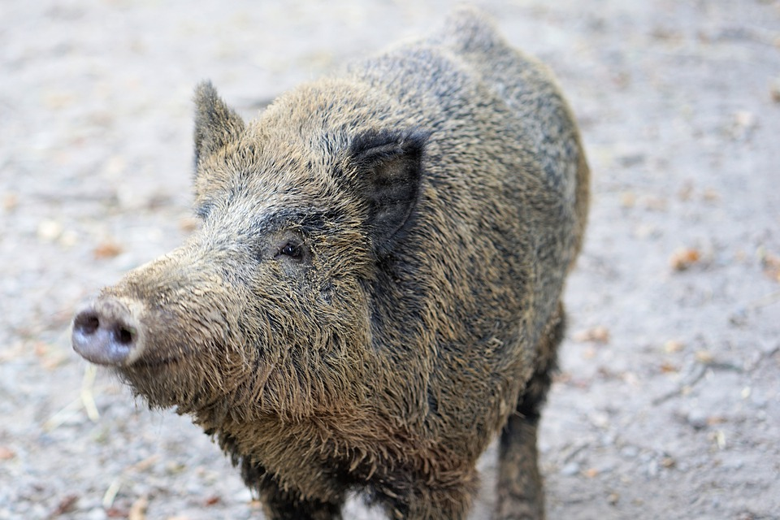
- The wolf is from 100 to 170 centimeters long
and from 66 to 81 centimeters tall.
- It weighs between 16 and 18 kilograms.
- Its tail is 35 to 50 centimeters long.
- Its colour is grey and brown and black.
- It eats deer and wild pigs and hares and beavers.
- Some wolves live in Beskydy in Nýdek.
Beaver
Wild pig
Notes:
It eats…, wolves...

Slide 7
Wolves history
Since the 17th century, there have been fewer wolves in the Czech Republic. They were wiped out in the 19th to 20th centuries. 5 March of 1415, the last wolf was shot dead in the Boleyn. They came to us again from Slovakia. Until 2021, there are between 6 and 10 wolves.

Slide 8
The third animal:
Brown bear

Slide 9
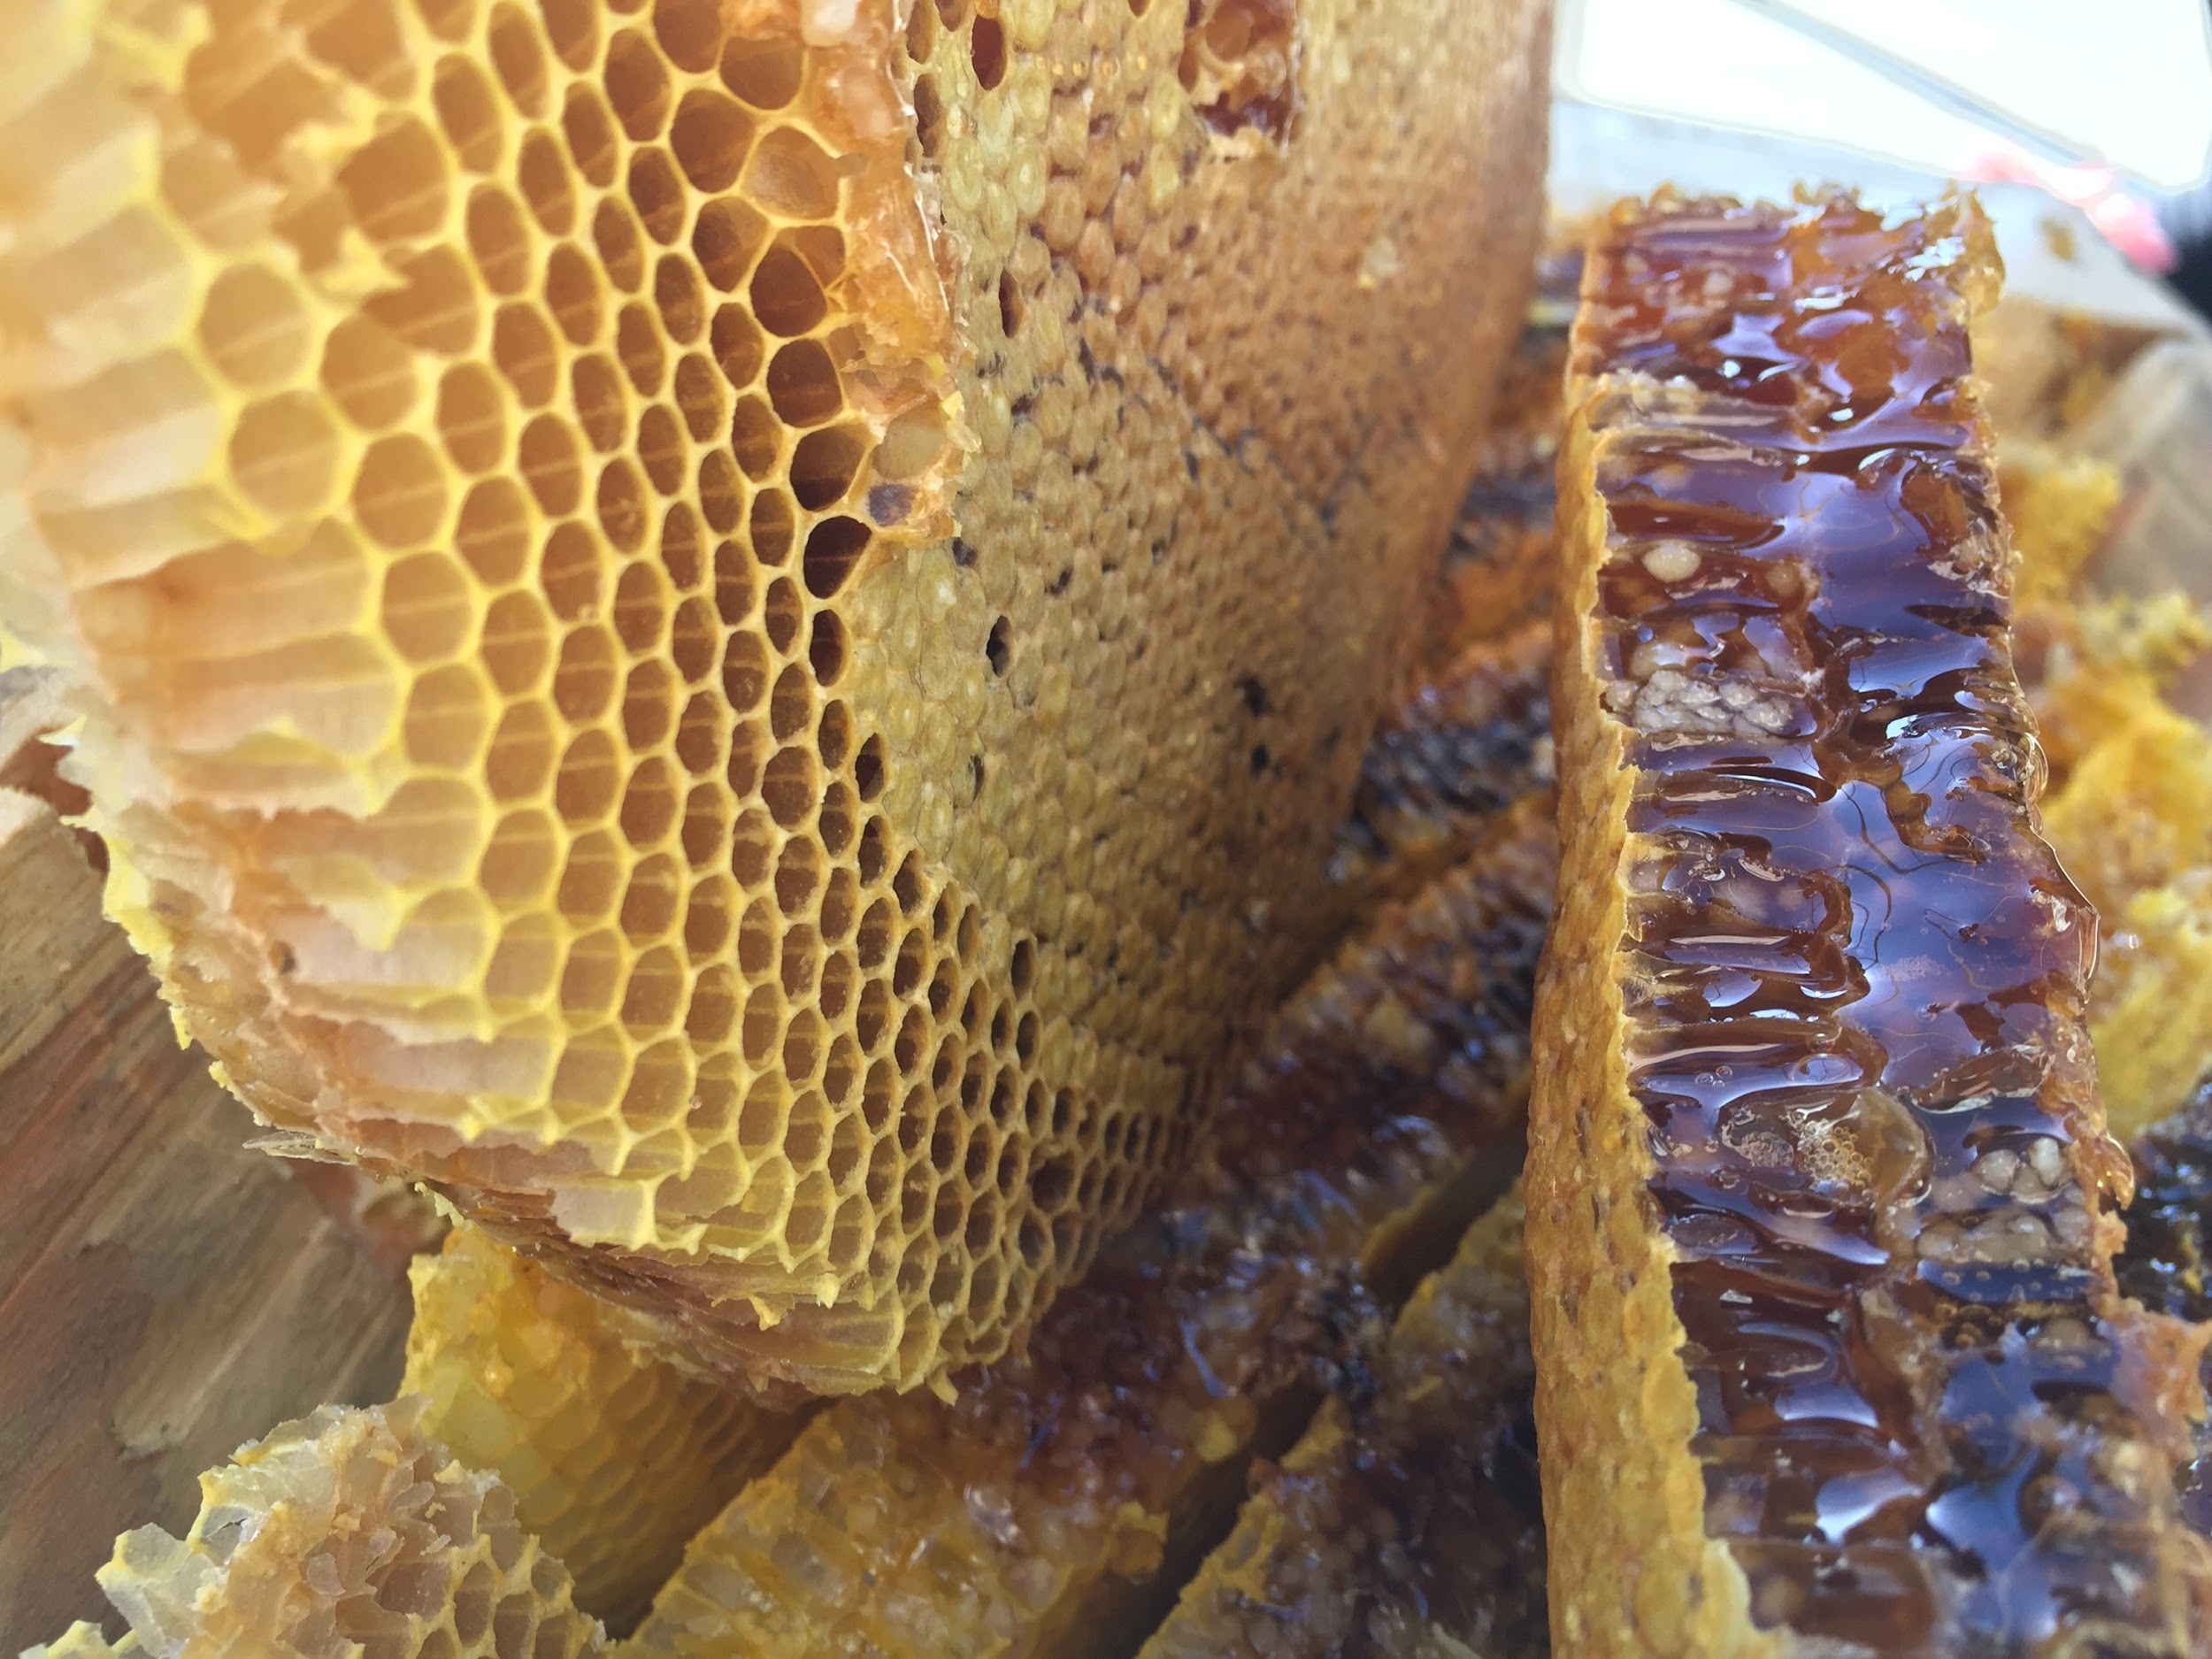
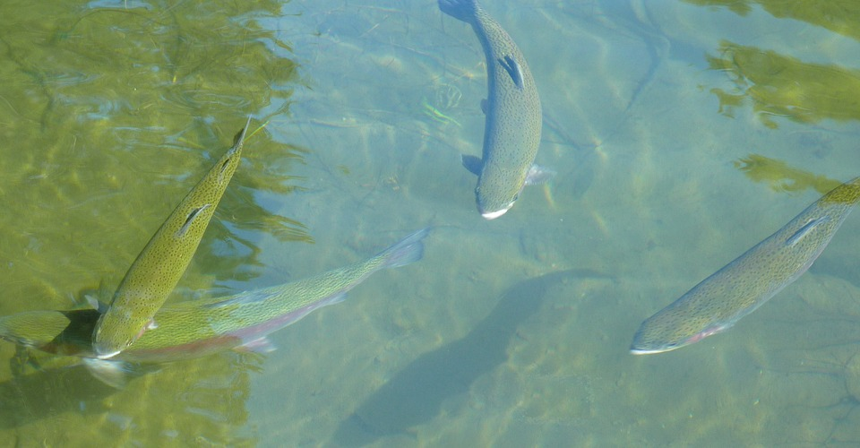
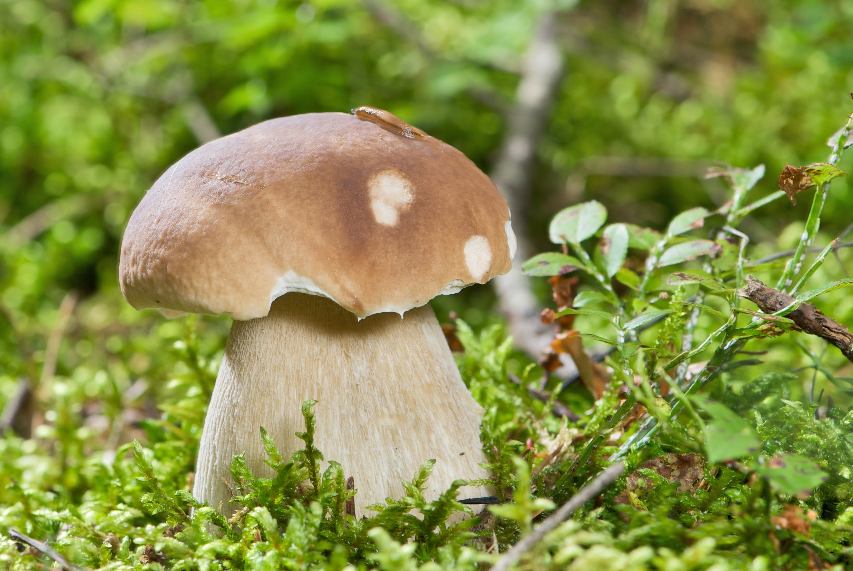
The bear is from 100 to 220 centimeters long and 150 centimeters tall.
It has a small tail.
It weighs from 100 to 550 kilograms.
In nature, it lives up to 30 years.
He's all brown.
The bear eats everything from deer and fish to plants and insects.He also likes to eat honey from the forest bees.
One bear lives with us in Beskydy.
Bears food

Slide 10
Bears history
The bear at once is descended from a cave bear. The cave bear lived in caves in the Middle Ages. It was up to 4 meters high. In the Czech Republic there is a skeleton of this bear in the Column - the Shoshovian caves.

Slide 11
the fourth animal:
Boar

Slide 12
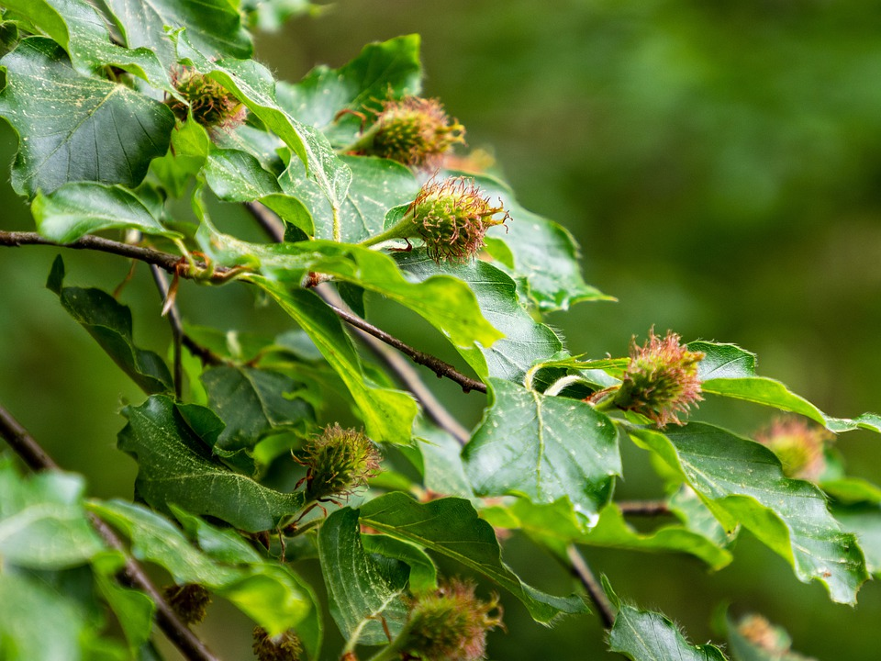
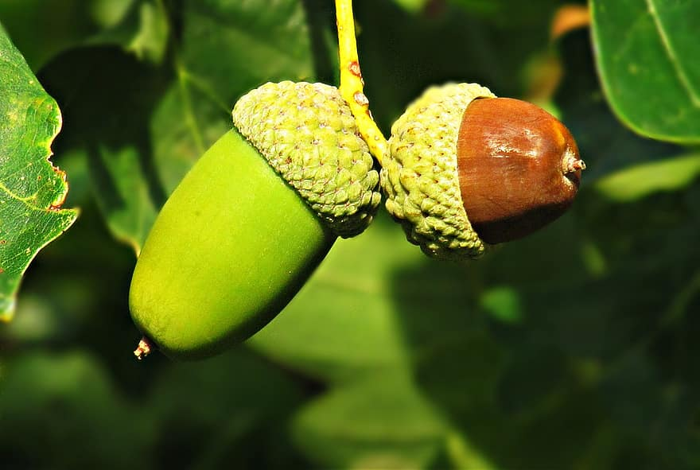
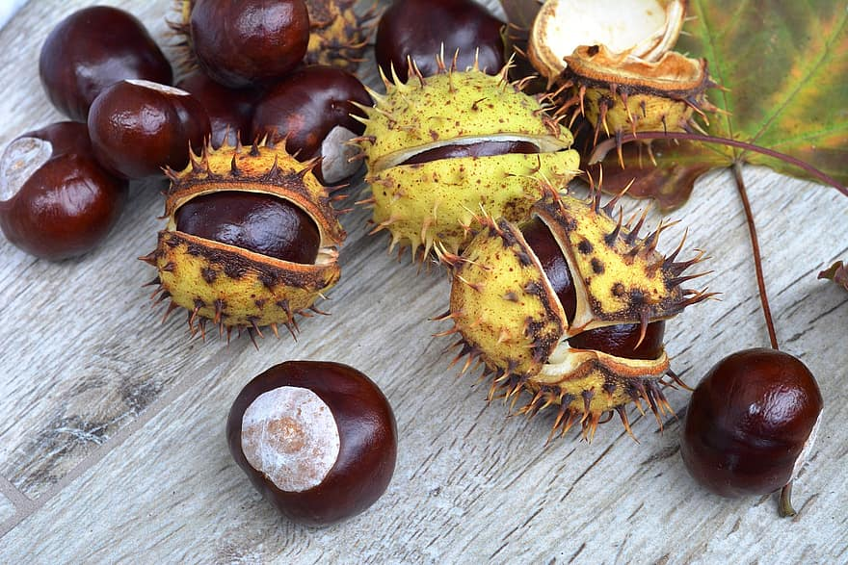
- It is from 120 to 180 centimeters long
and from 55 to 100 centimeters high.
- it weighs from 50 to 90 kilograms.
- Its colour is brown and grey.
- It eats beech and acorns and
sometimes chestnuts.
beech
chesnut
acorn

Slide 13
Boar - history
In the past, pigs were scarce in the Czech Republic. More wolves lived here. After that, there was no wolf. People began hunting wild pigs. It was fun for them. Now boars are only shot when they need to be.

Slide 14
Thanks for your attention

