Slide 1
LOCAL HISTORY
Traditional clothes in Silesia

Slide 2
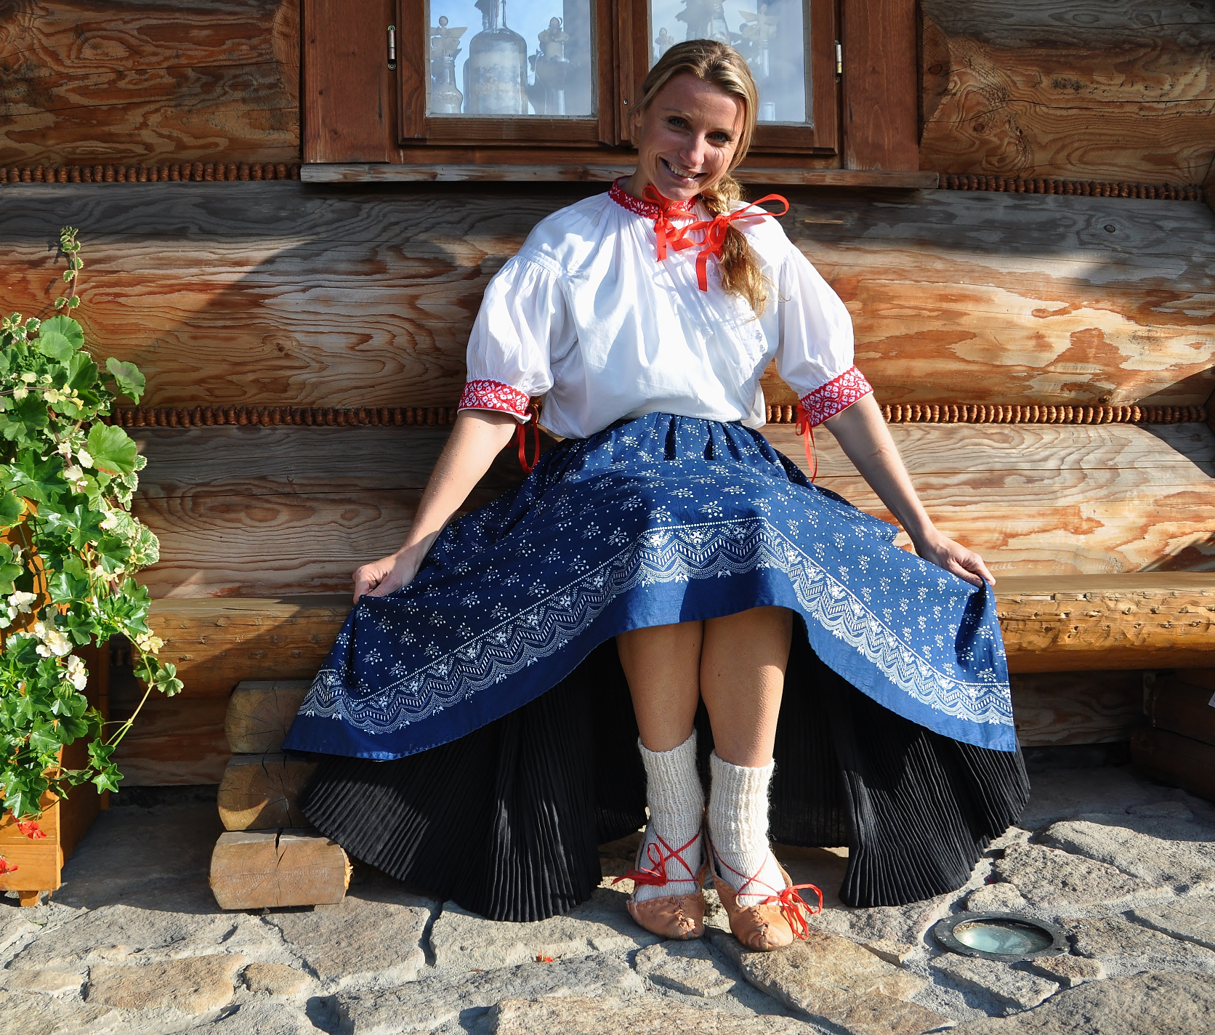
Traditional clothes in Silesia was a costume.
Traditional costumes are devited into four types:
- Silesian National costume
- Men’s costume
- Female costume
- costumes in Opava and Ratibořice

Slide 3
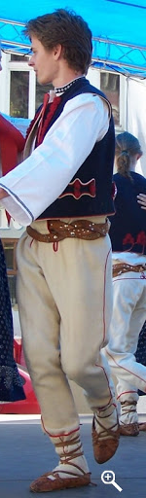
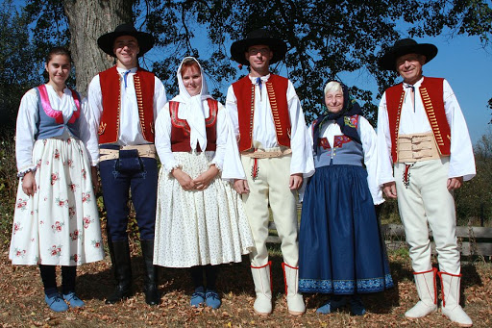
Men’s costume
Silesian National costume

Slide 4
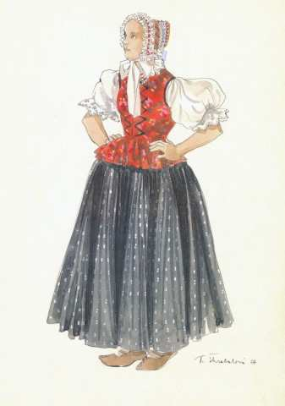
Female costume

Slide 5
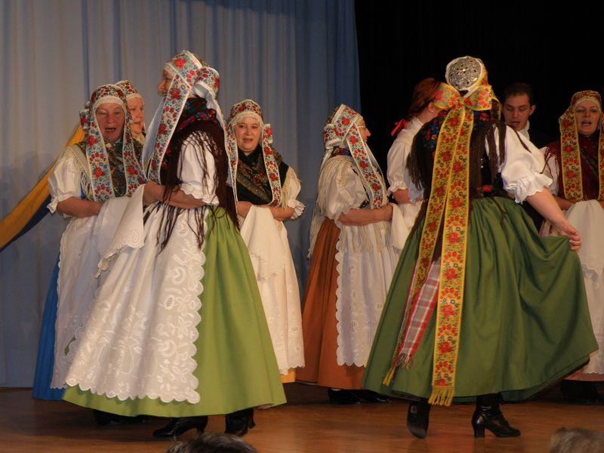
costumes in Opavia and Ratibořice

Slide 6
Thank you for your attancion

