Slide 1
LOCAL FOOD

Slide 2
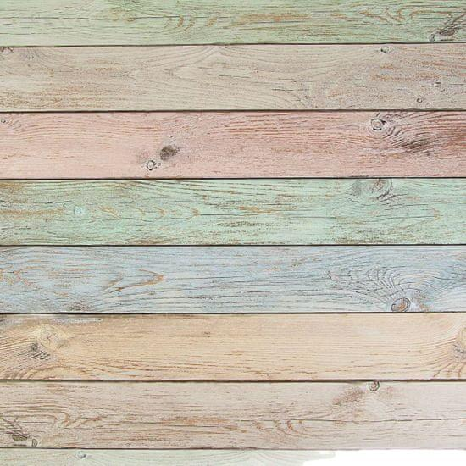
INTRODUCTION
Our Silesian cuisine is quite rich. People love potato pancakes. Popular desserts include crumb cakes, poppy seed cakes, sourdough or potato dumplings with strawberries or blueberries. We also like stewed fruit, salads and such various mixed fruits or vegetables.

Slide 3
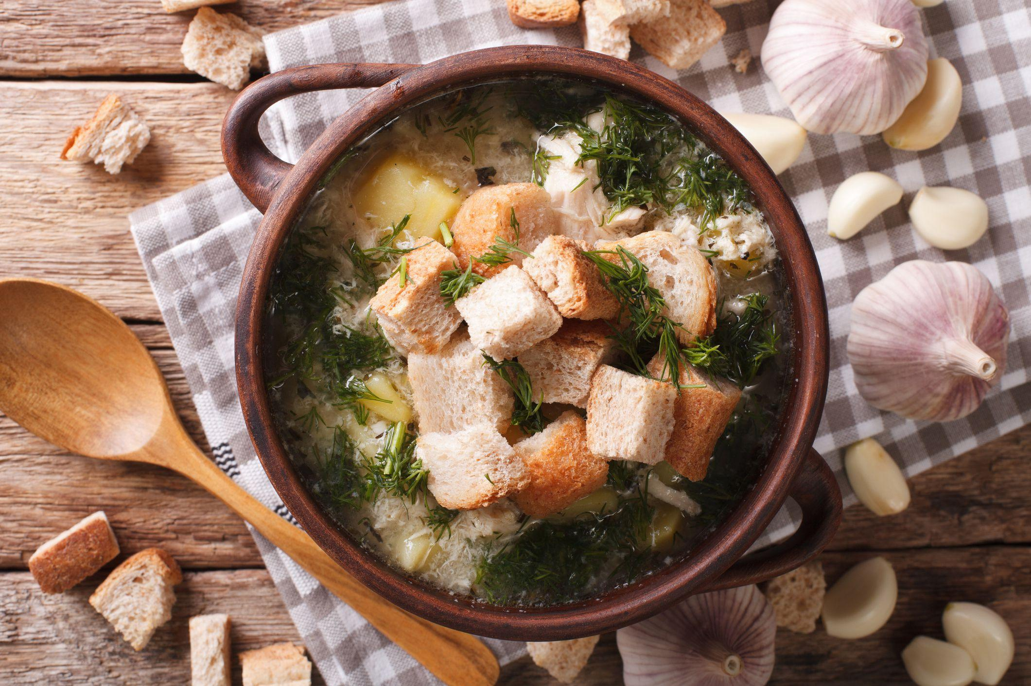
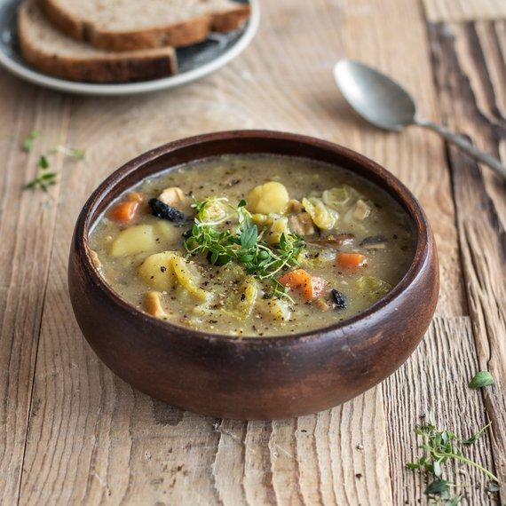
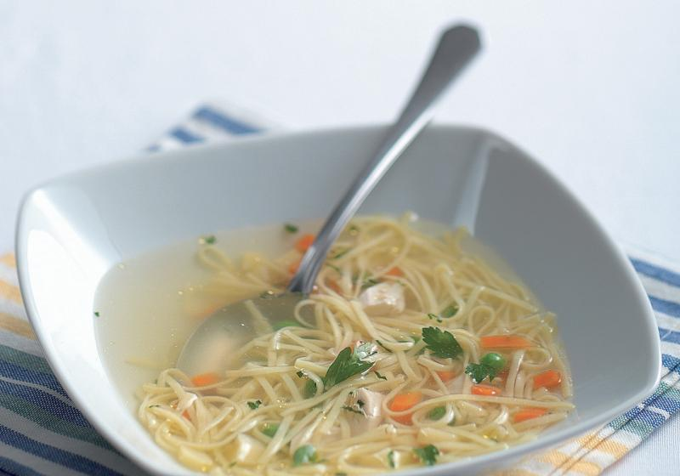
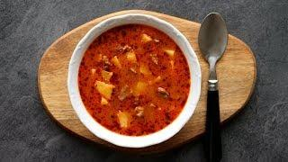
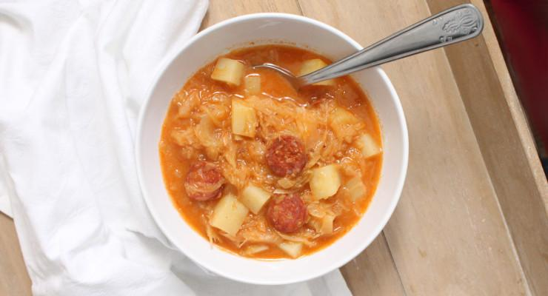
SOUP:
BEFORE
GARLIC SOUP
POTATOE SOUP
NOW
NOODLE SOUP
GOULASH SOUP
CABBAGE SOUP

Slide 4
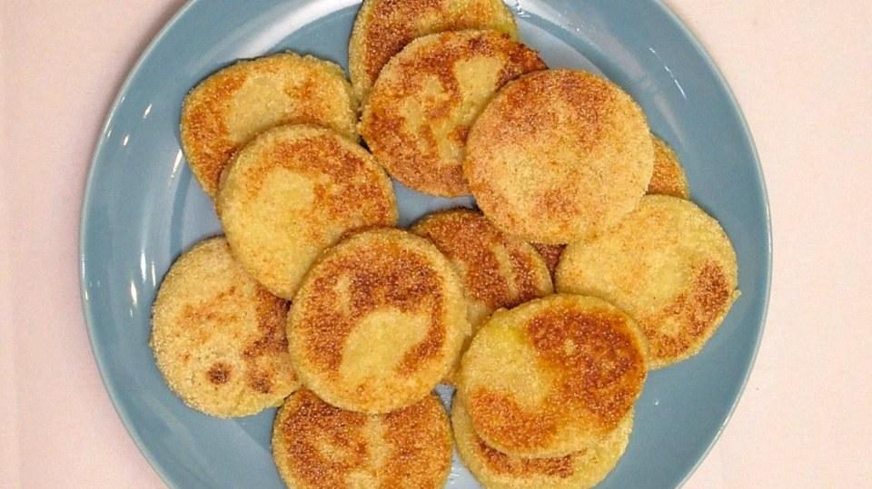
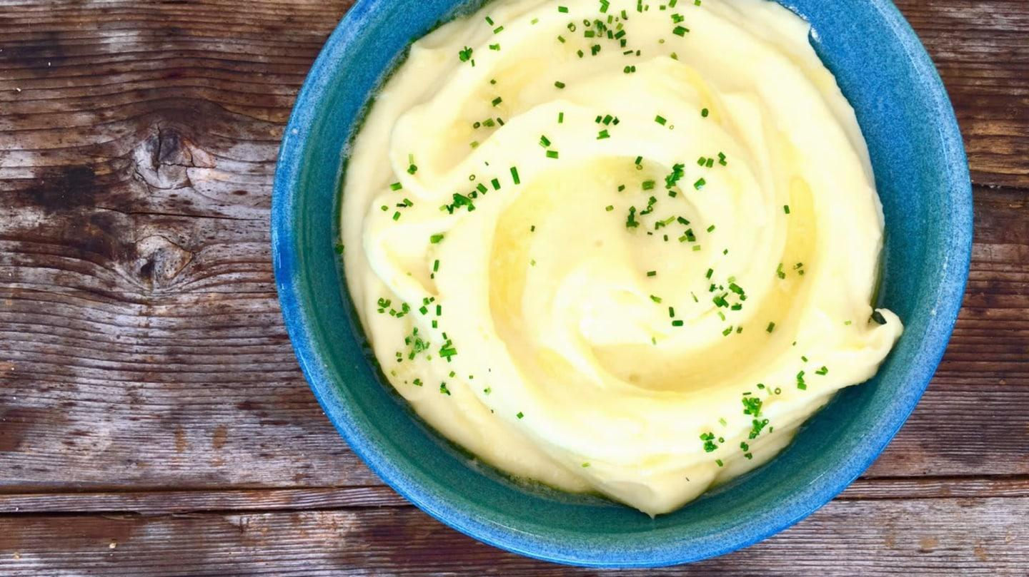
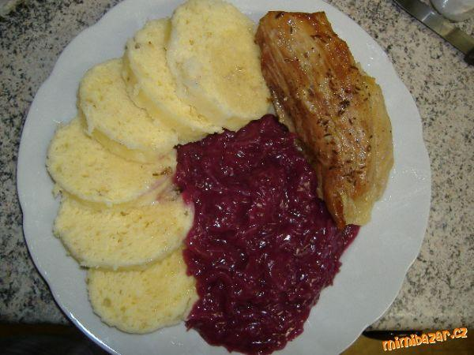
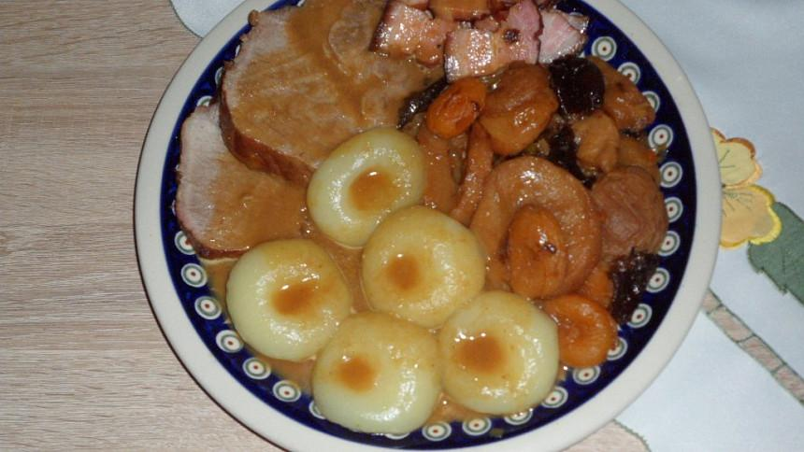
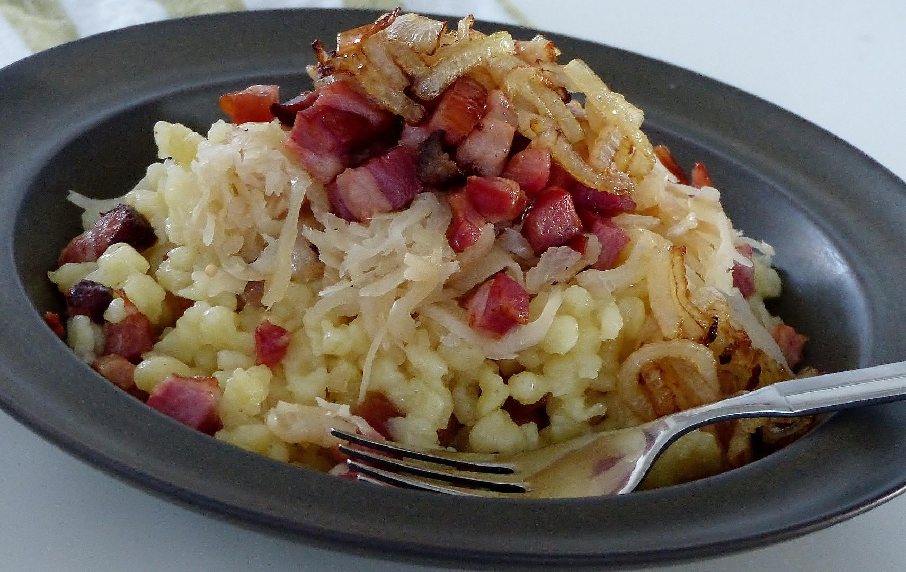
MAIN MEAL:
BEFORE
POTATO PANCAKES
MASHED POTATOES WITH MILK OR"KYŠKA"
NOW
SILESIA HEAVEN
PORK-DUMPLINGS-SAUERKRAUT
The main dishes we eat here are "stryky" and "halůšky"
glosary:
KYŠKA - fermented milk.
STRYKY - a dish of raw potatoes fried in fat.
HALŮŠKY - dish of potatoe dumplings

Slide 5
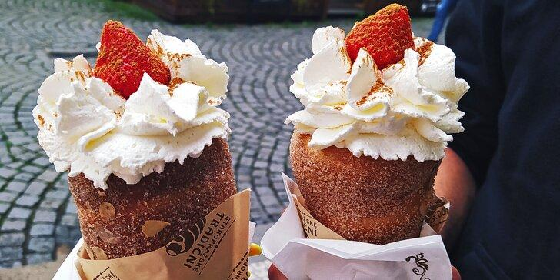
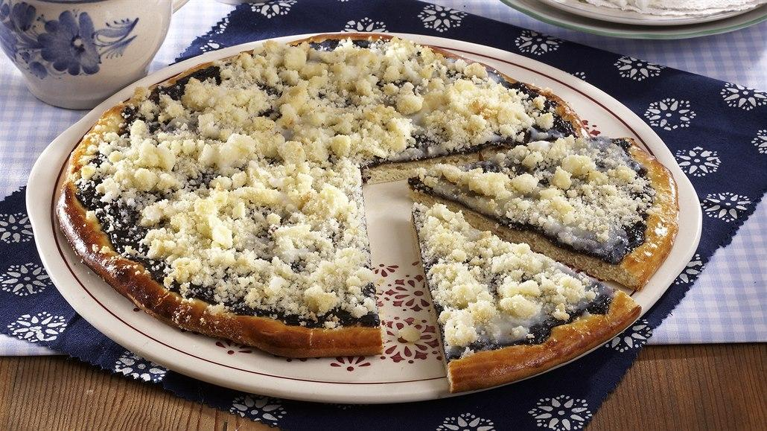
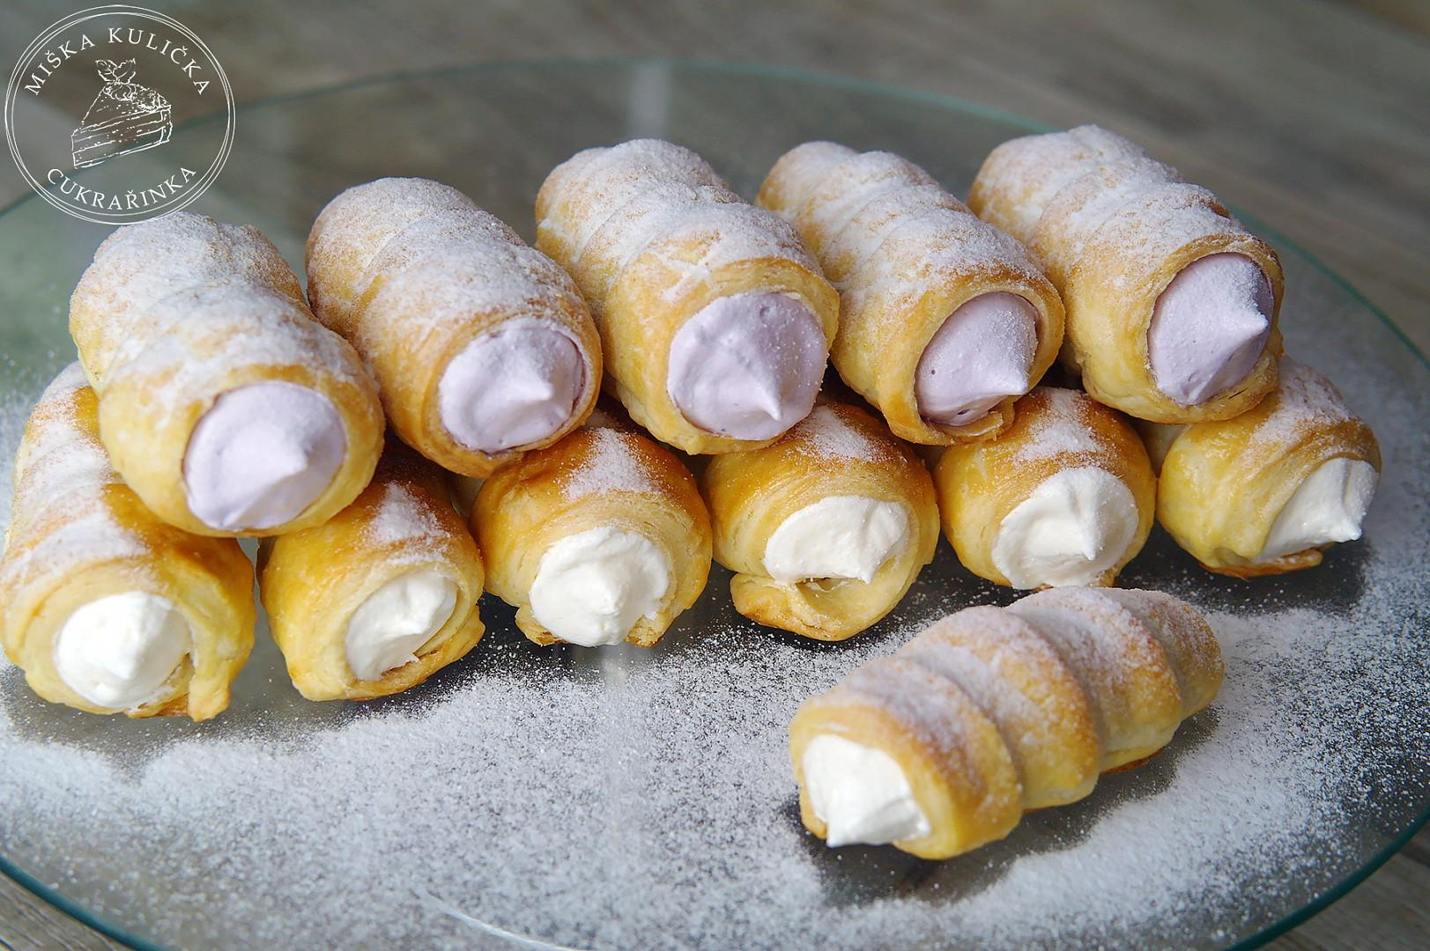
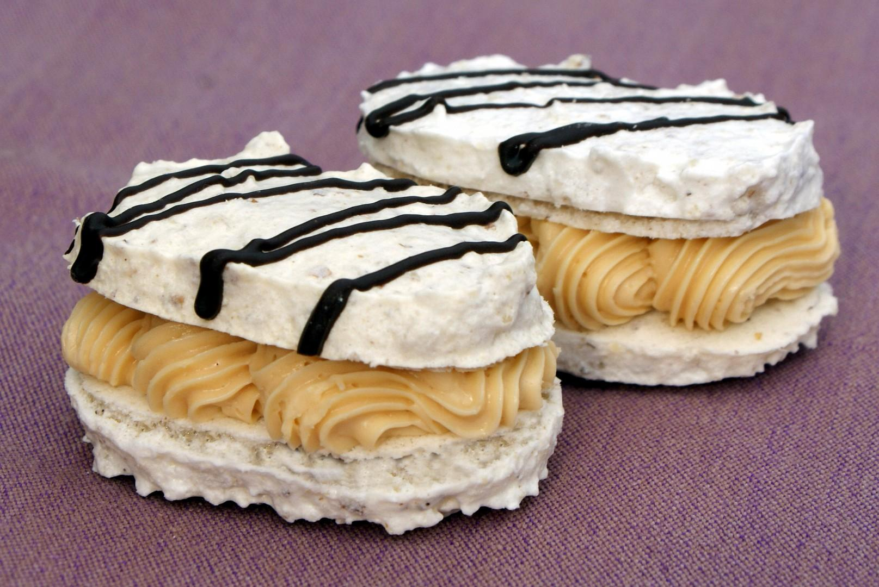
DESERTS:
BEFORE AND NOW
“TRDELNÍK“
“FRGÁL“
“KREMROLE“
“LASKONKY„
These dishes are usually served at some festivals.

Slide 6
RECIPE FOR „STRYKY"
Ingredients 4 servings
2-3 cloves of garlic
150 ml oil
2 eggs
1 kg of potatoes
10 ml milk
120 g plain flour
According to taste
salt
marjoram
ground black pepper
Peel the raw potatoes, wash them and grate them. We partially drain the water. Season the grated potatoes with salt and pepper. Add eggs, marjoram, flour and milk as needed so that the dough is not firm. Put a spoon of the prepared potato mixture into the hot fat in a pan, spread it on a pan and fry until it’s golden on both sides. Golden „stryky" are served hot or cold. It depends on the way we love them.

Slide 7
THANK YOU FOR WATCHING!

